Slide 1
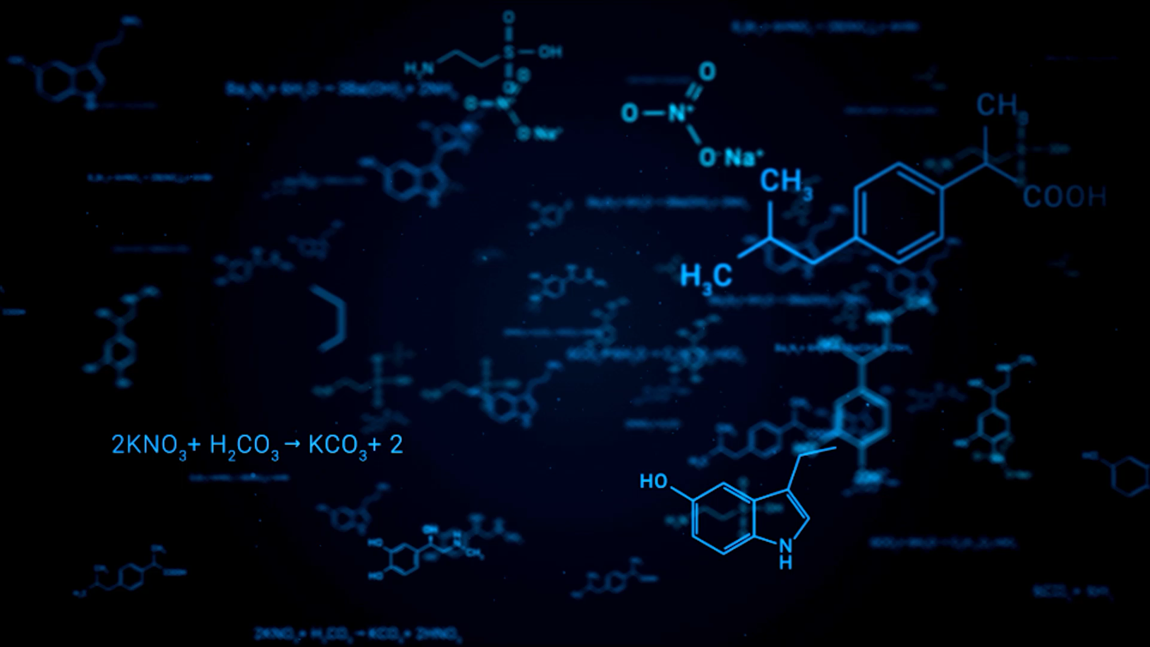
Structure-based protein-ligand binding prediction
Yaoding Chen | BS6207 Project
Reviewed by: Jingyi Hu, Jingyu Long
Notes:
Good evening everyone. Today I will make a presentation about my project, which is structure-based deep learning for protein-ligand binding prediction. Here I would like to thank Jingyi and Jingyu who reviewed this presentation.

Slide 2
Outline
Problem statements
Dataset description
Data pre-processing
Model description
Model evaluation
Conclusions
Future directions

Slide 3
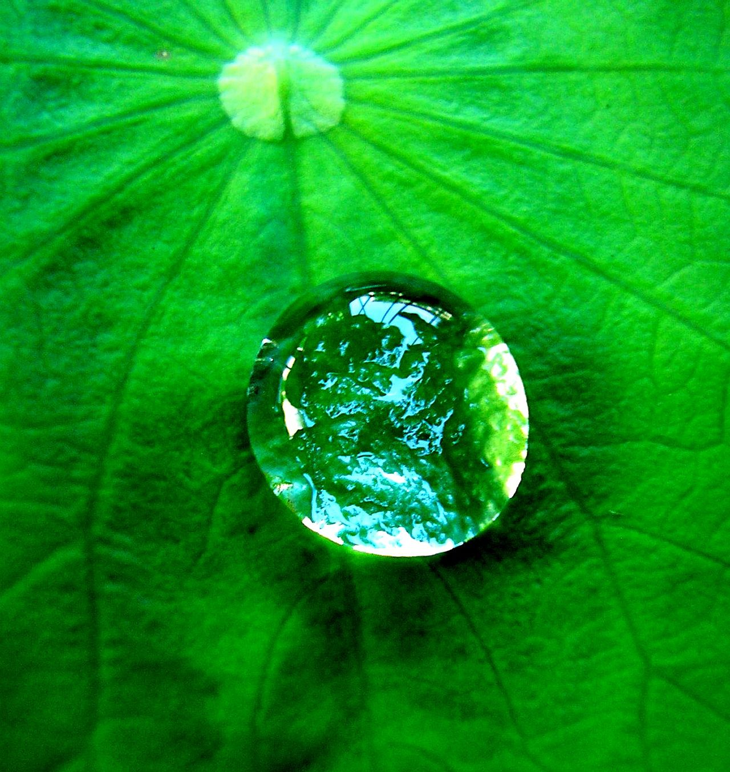
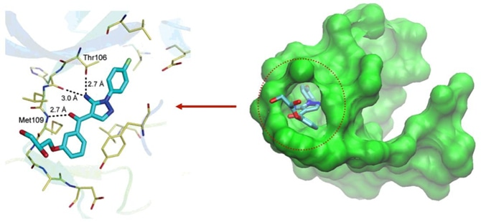
Problem statements
Biochemical background:
Ligands specifically bind to proteins via structural pockets
Hydrophobic and polar atoms have high affinity to themselves
Notes:
Let’s first start with some biochemistry background of protein-ligand binding. Here I show a figure that there is a water drop in a leaf. Because the leaf surface is covered by lipid layers, water molecules are repelled by the hydrophobic layers, thus forming a waterdrop. The simple chemistry here is that different atoms and molecules have different degree of attraction to each other, which we call affinity.
Here on the right we can see a cave in a large protein that harbors a smaller molecules, which can be called a ligand. Ligand has atoms that show high affinity to this pocket-like cave structure due to strong affinity between its specific atoms and the protein substructure. This process is called protein-ligand binding.

Slide 4
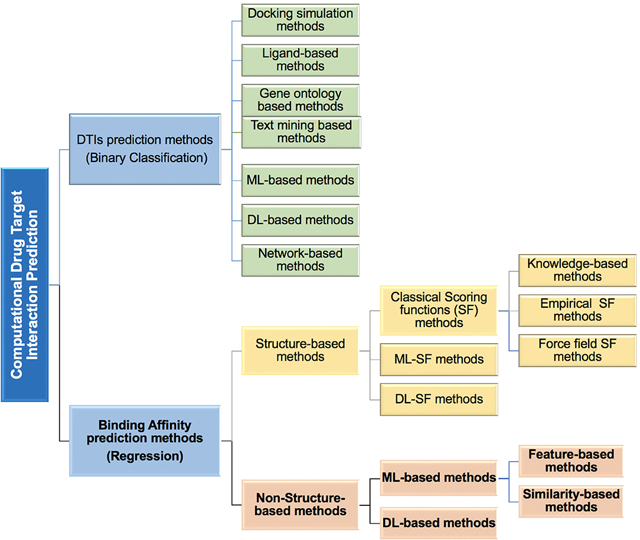
Problem statements
Important to drug target identification (DTI)
Challenges for machine learning
Diversity and complexity of protein and ligand structures
Vast amount of known and unknown proteins and ligands
Notes:
This process is important to drug development, which needs to target proteins in the body. However, due to the diversity and complexity of the protein ligand structures, it is hard to understand the binding mechanistically. There are vast amount of known proteins with unknown ligands and known ligands without known proteins in the nature, which could all be of high importance to biomedical research and clinical therapeutics. Thus, there are a number of machine learning and deep learning models developed for this prediction, as shown on the right. As we have mentioned earlier, we will talk about structure-based deep learning approach.

Slide 5
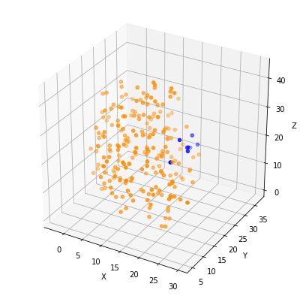
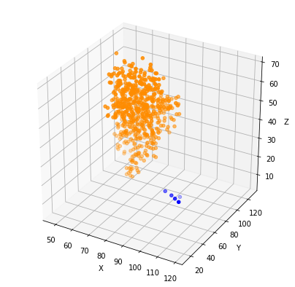
Dataset description
Training dataset
Positive pair, same indices
3000 proteins, 3000 ligands
Testing dataset
No ground truth
824 proteins, 824 ligands
Positive sample
Negative sample
Notes:
Our training dataset include 3000 proteins with indices paired ligands. The testing dataset include 824 proteins and 824 ligands, with their interaction not known. Here we visualize them in the right two graphs. The paired protein and ligand seems to be close to each other in the graph while the unpaired are not.

Slide 6
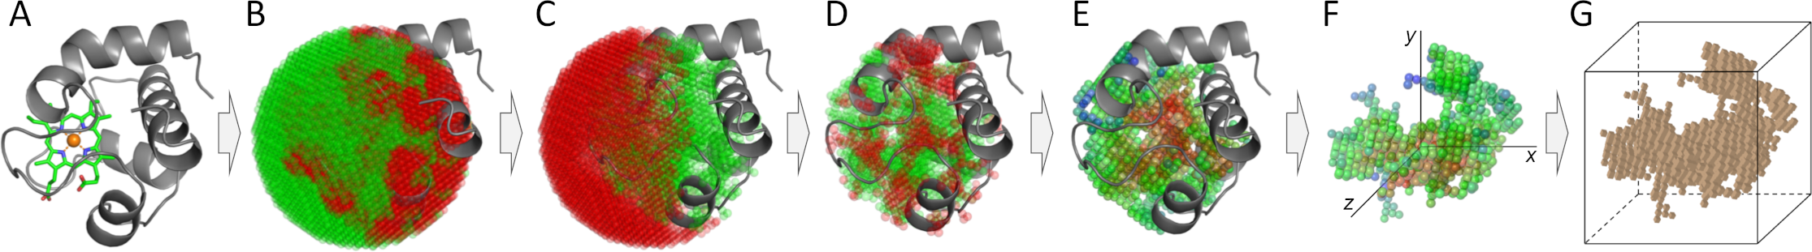
Data pre-processing
Voxelization
Protein + ligand of different sizes
> cube size 256 > centre > 8x rescale > an image with fixed size > stacking
Thus, a 3D image classification problem
2 channels: hydrophobic vs. polar
Illustration of voxelization. Taken from Pu et al., 2019
Notes:
Since the protein and ligand have diverse atom number, hence input data size. We need to normalize the data. This is achieved with what is called voxelization. First, we centered the protein or ligand in the center of an imagined 256*256 cube. Then we rescale it to 8 times smaller, thus, we have a relatively small 3D input with a fixed data size. This input can be viewed as a 3D image. Thus, the problem of protein-ligand binding can be restructured as a 3D image classification problem. Thus, we can use a 3D CNN to solve this problem, where the hydrophobic and polar attributes of atoms can be considered as two channels of the image, encoded in 1 or -1.

Slide 7
Data pre-processing
Sample constructed from training data
positive : negative = 1:1
train/test split (2:1)
Predictions on testing data to select top 10 candidates
Positive sample
Negative sample
Notes:
Since we don’t have ground truth for our test dataset, we need to resample from our training dataset. First, we generated positive and negative pairs by 1:1, and split the new training / testing dataset by 2:1. Then we aims to predict the probability of protein binding of all pairs of possible binding exhaustively. Then for each protein, we select top 10 candidates as our output.

Slide 8
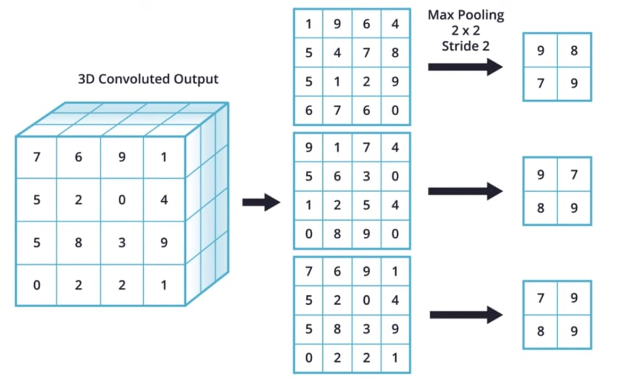
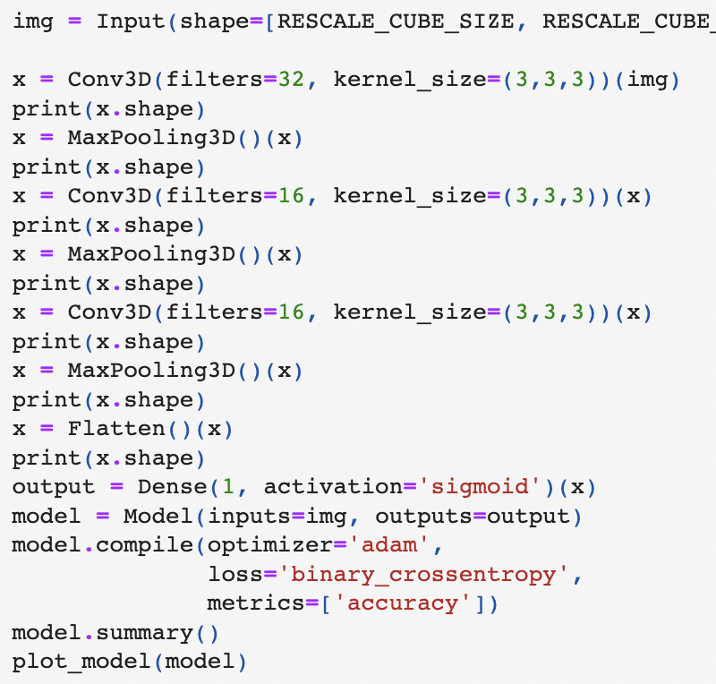
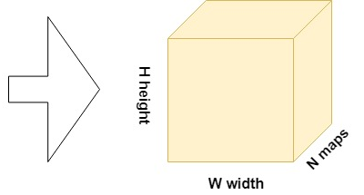
Model description
3D max pooling for downscaling & removing Invariances
Ref: https://dev.to/sandeepbalachandran/machine-learning-max-pooling-with-color-images-2i21
Notes:
The model is described on the right. For each convoluted result, we performed maxpooling for downscaling & removing Invariances, thus the sharpest features of the image can be extracted. We used 3 3D convolutional layers, each followed by a max pooling layer, until the results are flattened and fed into sigmoid activation function for probability prediction.

Slide 9
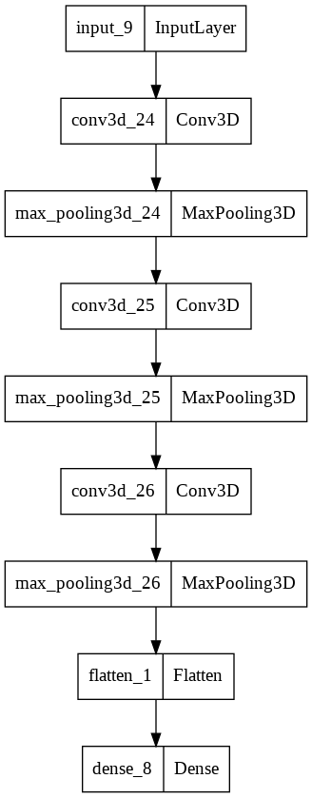
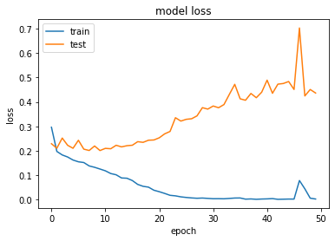
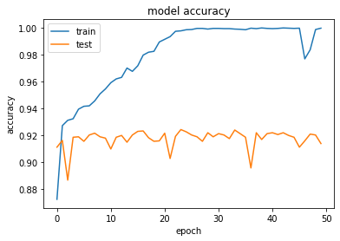
Model description
3D convolutional neural network (CNN)
Adam + 50 epochs + binary cross entropy > 92%
Overfitting here!
Notes:
We use Adam optimizer and binary cross entropy loss in the model, and run it by 50 epochs. The results are shown in the figure. The accuracy gradually became steady at around 92% in the testing dataset. However, it is interesting to notice that the loss goes up, suggesting overfitting.

Slide 10
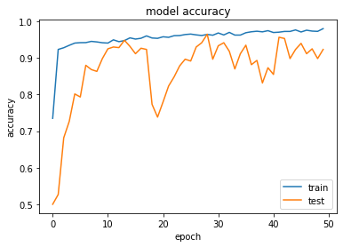
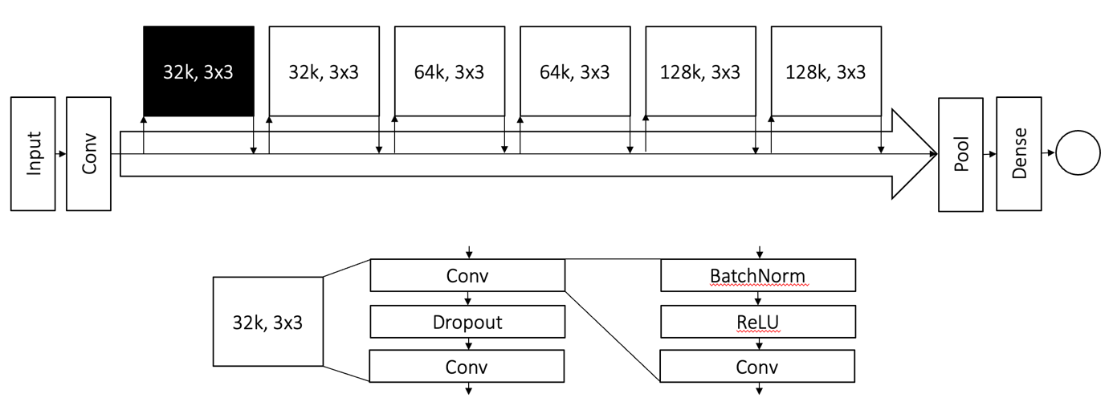
Model evaluation
Cross-validation on training datasets
Comparison with predictions of a previous model (DeepPL)
best accuracy 94%
Notes:
We also run a previous DeepPL model on Github, which uses a series of more advanced layers to the model, including dropout, batch normalization and relu as shown above. The model can reach an accuracy of 94% in the end and trains much faster than my model.

Slide 11
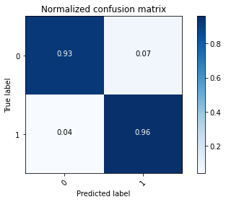
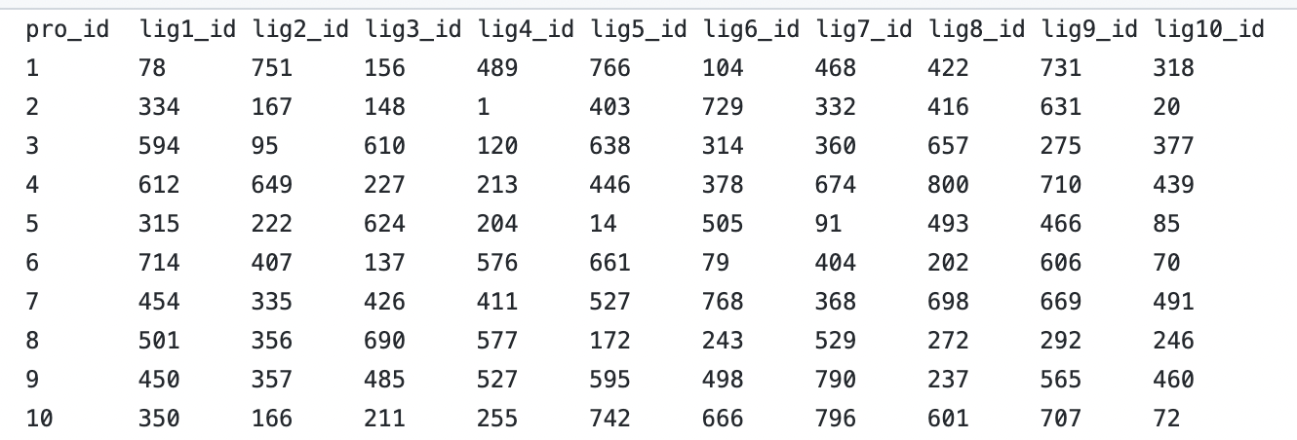
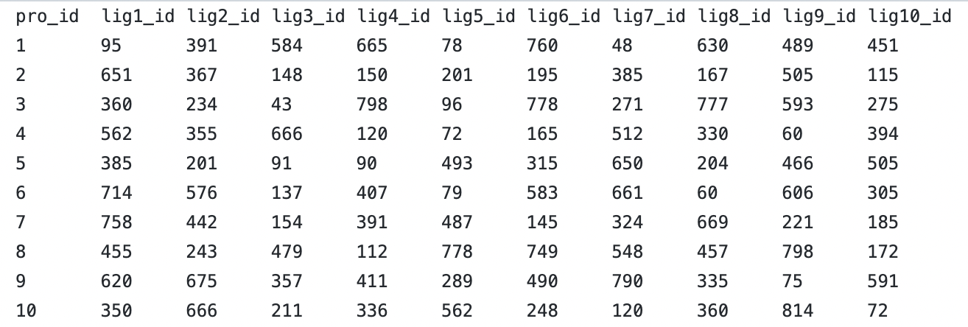
Conclusions
Prediction results mostly consistent with earlier model predictions, despite some inconsistencies
DeepPL predictions
3DConv predictions
To get indices: np.argsort(-res.flatten())[0:10] + 1
Notes:
Thus, we can propose our top 10 candidates with the testing data, after we used the training dataset for further cross-validation within itself. As shown in the heatmap, the accuracy is always above 93% for these models. This suggests that we can have confident results in the testing dataset. So here is the output of the two models. Here we highlighted what are the same for each protein. Overall, the two models produce high similar model, which should be close the ground truth.

Slide 12
Future directions
Tuning of cube size
Modification to the model
Batch normalization & dropout
Wide resnet
Regularization
Data augmentation
Use graph neural network
Combine more features

